Slide 1
CI Agent

Slide 2
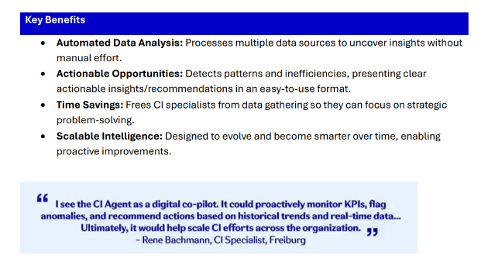

Slide 3





Data
Landscape
Key
Long Term Design
Users &
Data Scientists
Data Flow
Azure
Data Science Requests
End User Requests
CI
Questions
(End Users)
Data Analyst Requests
Fabric Agent
Requests
CI Agent
Answers
Non-Snowflake Data
LLM/Agents
(Azure AI Foundry)
CI Agent
Questions
Ideation Application
(App Service/Fabric)
CI
Users
Clusters
Analysis
Cluster
Results
Fabric Agent
Response
Analysis
Results
Clustering
Data
OneLake
(Fabric)
Clusters
Machine Learning
(Fabric)
Clustering
Data
(On Demand)
Fabric Data
Requests
Cluster
Implementation
(Data Science)
Data
Scientists
Snowflake
Data
Data Analytics
(Data Analysis)
Analytics
&
Dashboarding
(Fabric)
Fabric Data
Responses
Data
Analysis
Data Ingestion & Orchestration
(Fabric)

Slide 4





MvP
Key
Users &
Data Scientists
Data
Landscape
Not Shown
Azure
Data Flow
Data Science Requests
End User Requests
Azure API
Management
Microsoft Entra
CI
Questions
(End Users)
Non-Snowflake Data
Private Endpoints
LLM/Agents
(Azure AI Foundry)
CI Agent
Questions
CI
Users
Clusters
Analysis
CI Agent
Answers
Ideation Application
Microsoft Agent Framework
(App Service/AML)
Storage
(Azure Storage)
Analysis
Results
Cluster
Results
Clusters
Clustering
Data
Machine Learning
(App Service/AML)
Clustering
Data
(On Demand)
Snowflake
Data
Cluster
Implementation
(Data Science)
Data
Scientists
Data Ingestion & Orchestration
(ADF)

Slide 5
Agent Loan Processing

Slide 6
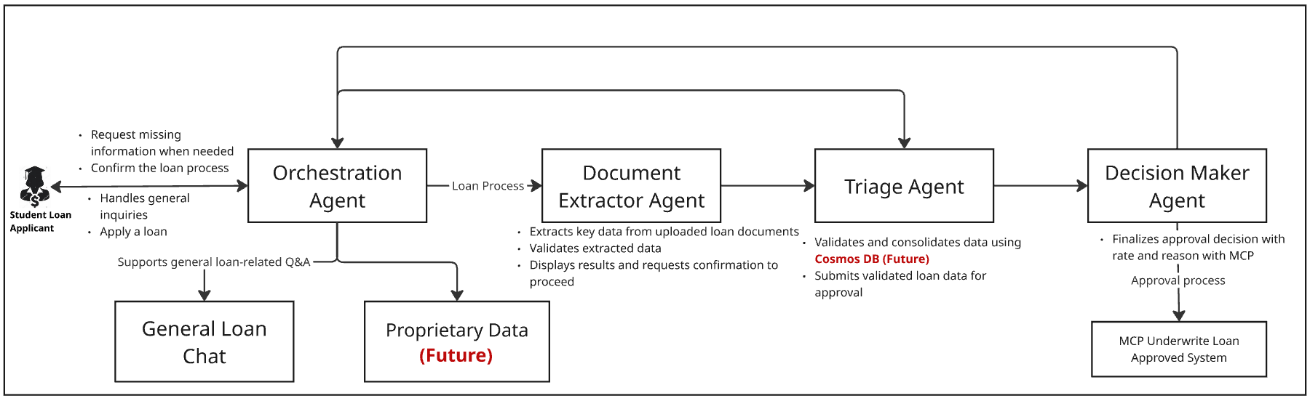
Overall Student Loan Processing
Notes:
Real-world evidence clinical protocols leverage data collected outside traditional clinical trials. This includes diverse patient populations and various healthcare settings to evaluate treatment effectiveness. Key considerations involve careful study design, the choice of data sources, and adherence to regulatory guidelines, ensuring that findings are valid and applicable in real-world scenarios.

Slide 7
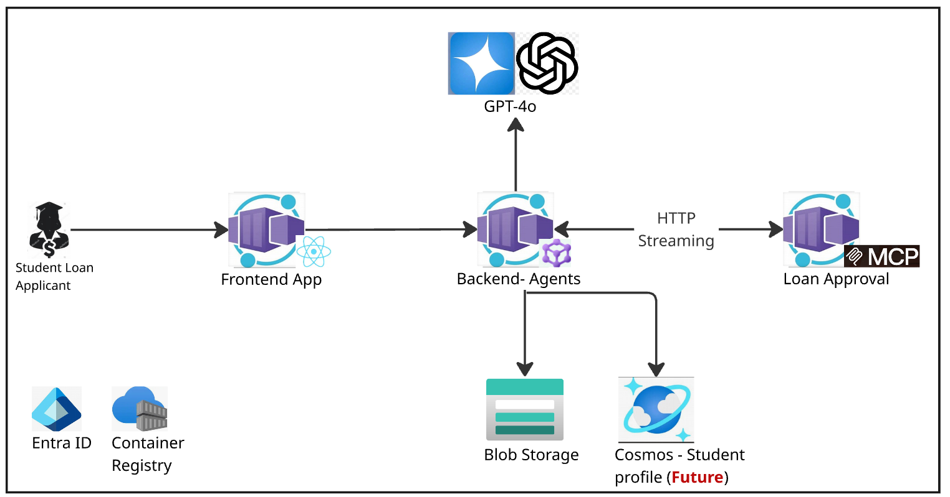
High-level Architecture (Detailed)| Data Flow and Consumption
Azure
Full Content Available on GitHub at: Azure-Samples/multi-agent-student-loan-processing-SA: Solution Accelerator to deploy a multi-agent solution using Microsoft Agent Framework.

Slide 8
Agent Loan Processing Demo

Slide 9
VoiceRAG: Voice using Azure AI Search and GPT for Audio

Slide 10
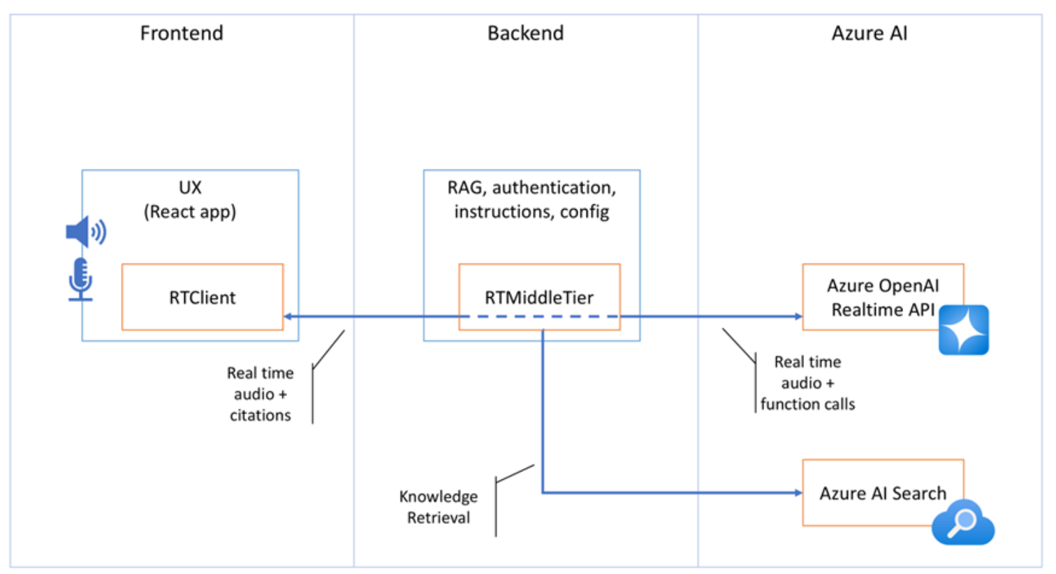
VoiceRAG Overall Process
Notes:
Real-world evidence clinical protocols leverage data collected outside traditional clinical trials. This includes diverse patient populations and various healthcare settings to evaluate treatment effectiveness. Key considerations involve careful study design, the choice of data sources, and adherence to regulatory guidelines, ensuring that findings are valid and applicable in real-world scenarios.

Slide 11
VoiceRAG Demo

